Slide 1



learn invent impact
Cybersecurity Arms Race
Suresh C. Kothari
Professor, Department of Electrical and Computer Engineering
President & Founder EnSoft Corp.
Acknowledgement: Team members at Iowa State University and EnSoft, DARPA contracts FA8750-12-2-0126 & FA8750-15-2-0080

Slide 2
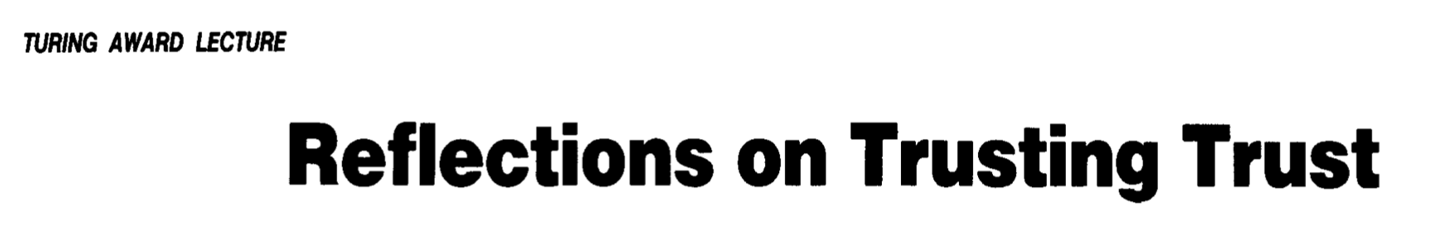
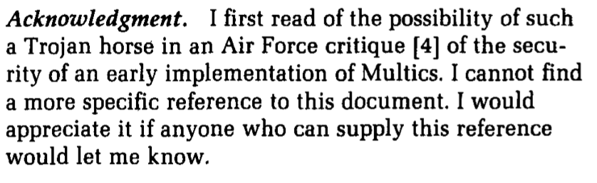

Slide 3
U.S. Airforce Report that motivated Thompson’s Speech
The compiler trap doors were first discussed in a 1974 U.S. Airforce report [1]. The trap doors were patches to the binary object files of the Multics operating system. The report suggested a countermeasure to such object code trap doors by having customers recompile the system from source, although the report notes that this could play directly into the hands of the penetrator who has made changes in the source code. In fact, the Airforce Multics contract specifically required that Honeywell deliver source code to the Pentagon to permit such recompilations.
The report pointed to the possibility that a trap door in the PL/I compiler could install trap doors into the Multics operating system when modules were compiled and could maintain its own existence by recognizing when the PL/I compiler was compiling itself.
This report became the basis several years later for the TCSEC Class A1 requirement for generation of new versions from source using a compiler maintained under strict configuration control [2].
Trap door = Malware
[1] 1974, P. A. Karger, U. Roger, R. Schell, Multics security evaluation: Vulnerability analysis, in: HQ Electronic Systems Division: Hanscom AFB, MA. URL: http://csrc.nist.gov/publications/history/karg74
[2] P. A. Karger, R. R. Schell, Thirty years later: Lessons from the Multics security evaluation, in: 18th Annual Computer Security Applications Conference, 2002. Proceedings., IEEE, 2002, pp. 119–126.

Slide 4
What is the progress since Thompson Turing Award speech?
1974
1984
2021
U.S. Airforce Report
Thompson Turing Award Speech

Slide 5
Progress Report
Compcert Compiler
The most cited research to address the problem of compiler trap doors is perhaps the Compcert compiler that generates PowerPC assembly code from Clight (a subset of the C programming language). The Compcert requires that the compiler itself be generated interactively using the Coq proof assistant [1, 2].
[1] S. Blazy, Z. Dargaye, X. Leroy, Formal verification of a c compiler front-end, in: Proceedings of the 14th International Conference on Formal Methods, FM’06, Springer-Verlag, 2006.
[2] X. Leroy, Formal verification of a realistic compiler, Communications of the ACM 52 (7) (2009) 107–115.
Diverse Double Compilation
The approach called Diverse Double Compilation (DDC) was the topic of a PhD thesis. In the DDC technique, source code is compiled twice: the source code of the compiler’s parent is compiled using a trusted compiler, and then the putative compiler source code is compiled using the result of the first compilation. If the DDC result is bit-for-bit identical with the original compiler-under-test’s executable, and certain other assumptions hold, then the compiler-under-test’s executable corresponds with its putative source code [3].
[3] D. A. Wheeler, Countering trusting trust through diverse double-compiling, in: 21st Annual Computer Security Applications Conference (ACSAC’05), IEEE, 2005, pp. 13–pp.

Slide 6
Progress
1974
1984
2005 to 2009
2021
U.S. Airforce Report
Thompson Turing Award Speech
Compcert & DDC
Papers
Is the problem solved?

Slide 7
Is the problem solved?
NO
In 2016, it was found that Microsoft Visual Studio 2015 Update 2 was quietly inserting telemetry calls into compiled programs by default, this was not documented and could harm privacy.
J. Martin, Microsoft’s automatic insertion of telemetry into c++ binaries:
https://www.infoq.com/news/2016/06/visual-cpp-telemetry/
Published remedies (Compcert & Diverse Double Compilation) are inadequate and impractical.
Fundamental challenge noted by Thompson not addressed.

Slide 8
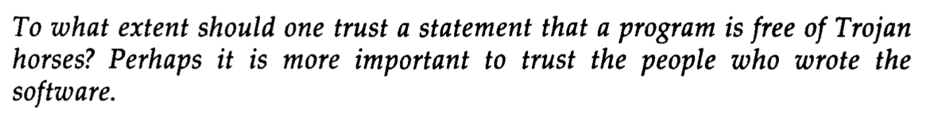
Enable a practical way for humans to compare the binary with the source and ascertain that binary would faithfully execute what the developer has written in the source code
Extremely challenging – we will come back to it in a future lecture

Slide 9

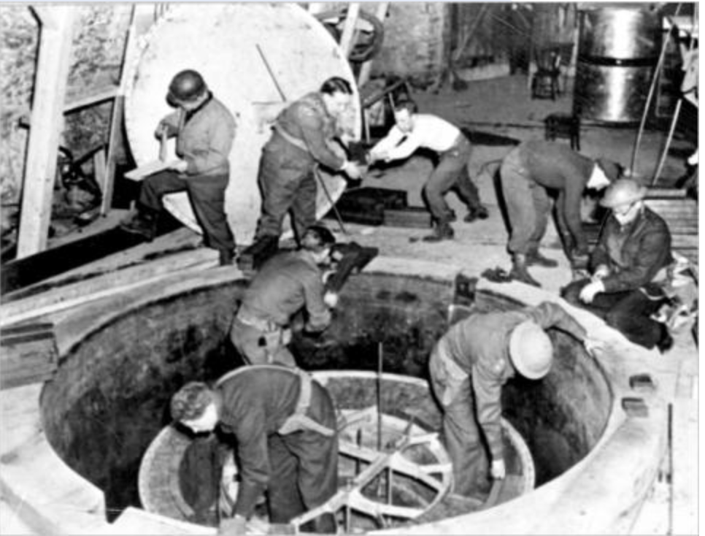
The New Race
1940’s Atomic Bomb Race
In his book The Perfect Weapon, David Sanger writes “Each technology goes through a cycle of development and weaponization, followed only later by the formulation of doctrine and occasionally by efforts to control the weapon’s use.” The Internet technology has developed rapidly, and it is now being weaponized to sabotage the electronic or physical assets of an adversary.
Today, Cybersecurity Race
?

